Slide 1
比特币底层 实现原理解析
持有、支付、挖掘比特币原理及协议
Andy Wu (吴增德）
2017－05－29
Notes:
Own, Send, Mine bitcoins

Slide 2
How Bitcoin Works
Andy Wu (吴增德）
2017－05－29
Notes:
Own, Send, Mine bitcoins

Slide 3
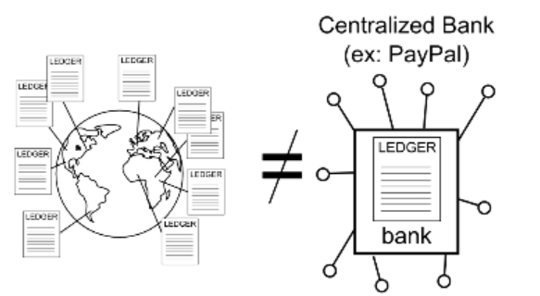
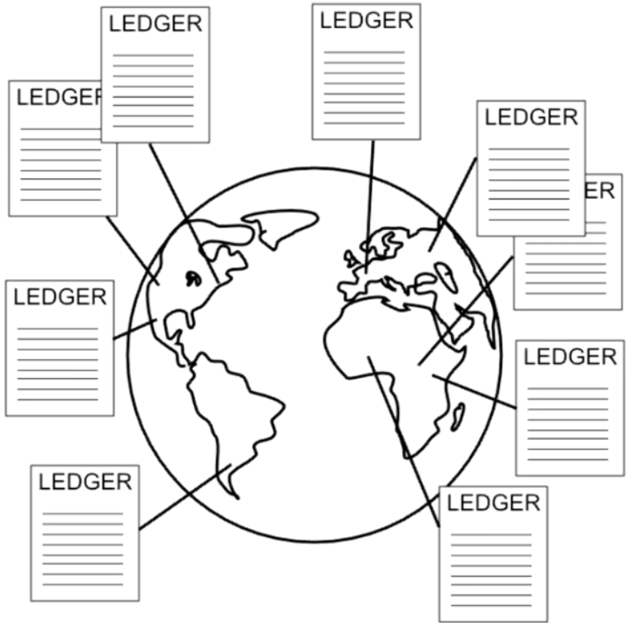
What is Bitcoin
Ledger
Alice | 5.4
Bob | 100
Frank | 700
Carlos | 0.0000001
… | 1
Notes:
How transaction is done
How to transfer
RSA
Bitcoin cryptography
HASH 256
To understand: blockchain.info
Youtube: blockchain.info

Slide 4
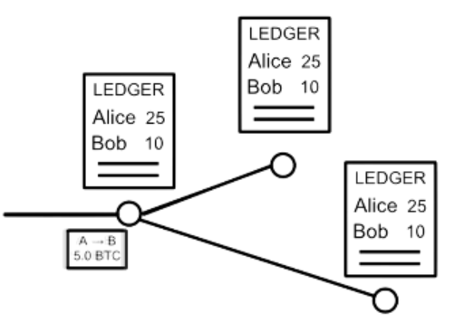
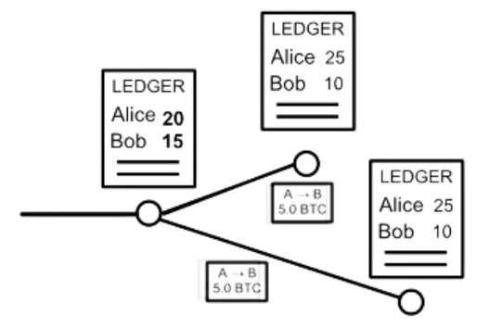
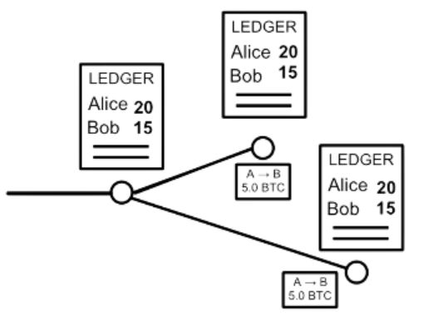
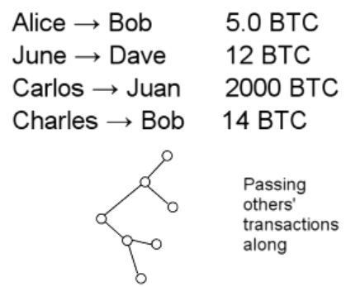
Sending Money
Alice → Bob 5.0 BTC

Slide 5
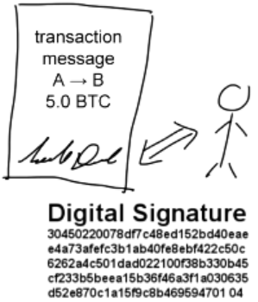
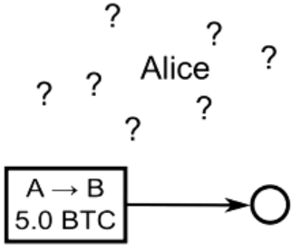
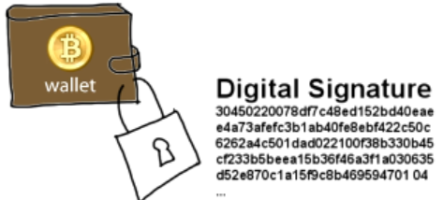
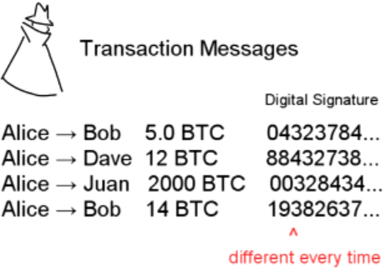
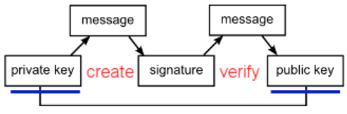
Sending Money & Authentication
Signature = f(message, private key)
1=? V(message, public key, signature)
Notes:
Think as:
Private key: true password,
Signature: intermediary proves having the password, without reveal it.
Public key: send to address in BTC

Slide 6
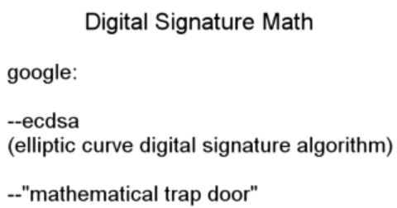
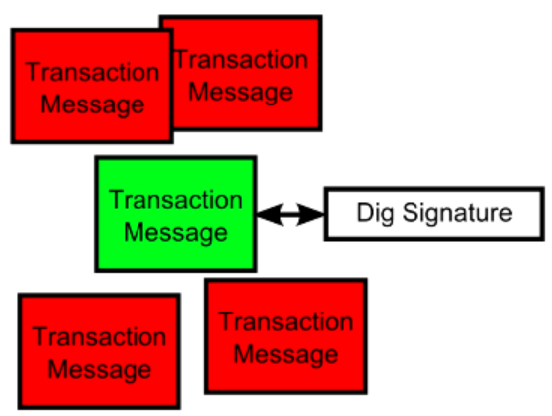
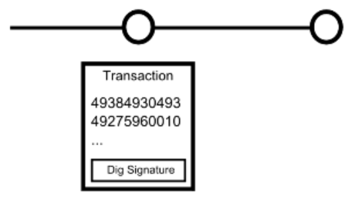
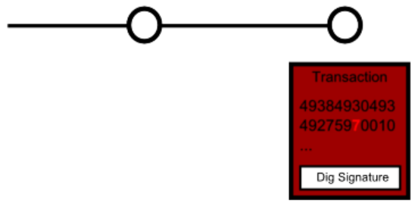
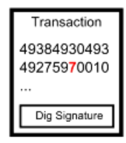
Digital Signature

Slide 7
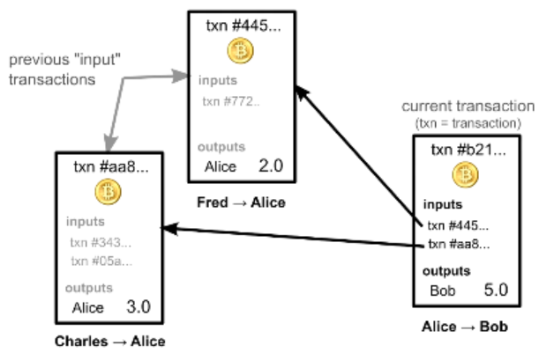
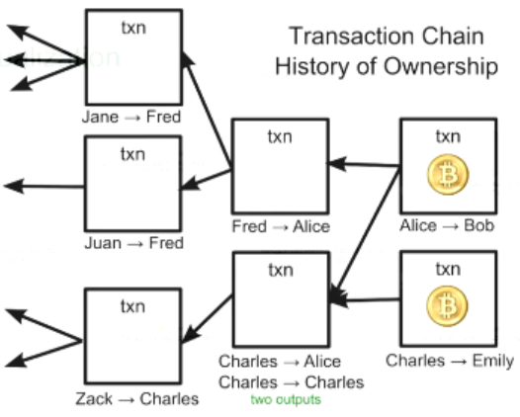
Account Balances
Ownership via previous transactions
Check previous transactions ~ 24h
Blockchain.info
Notes:
?? How the process pay 1.2, 2.5, 3.4

Slide 8
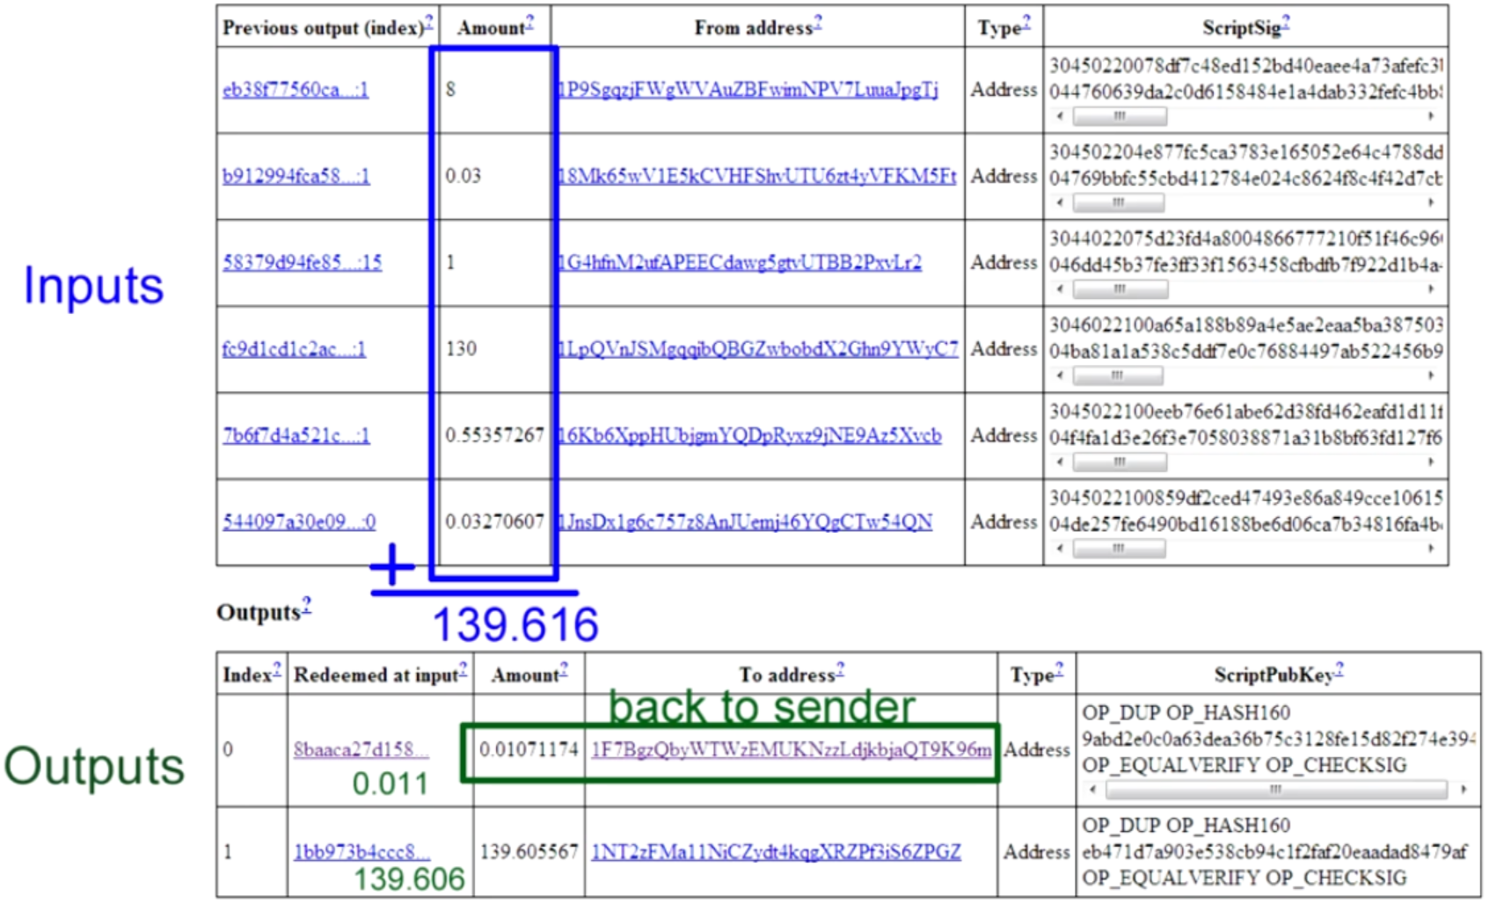
Real Transactions

Slide 9
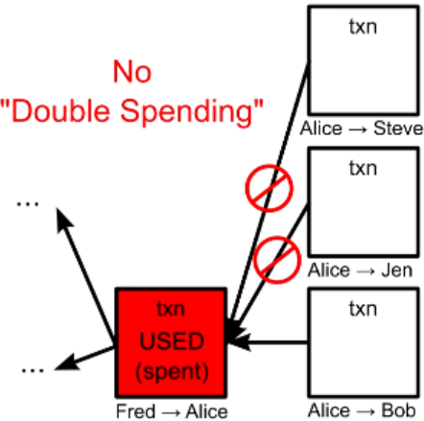
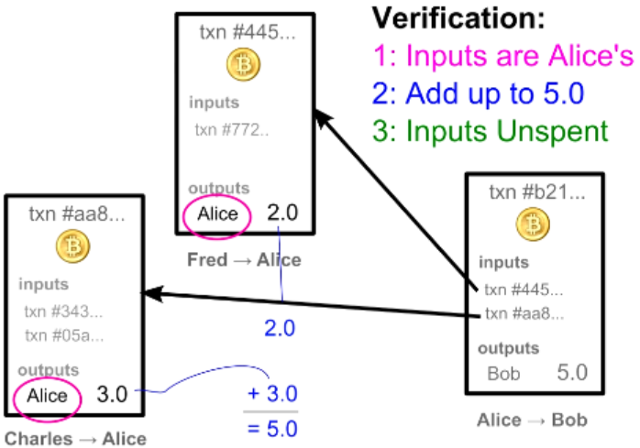
Transaction Verification
Each Transaction Can Only be Used Once as an input

Slide 10

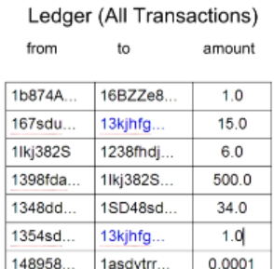
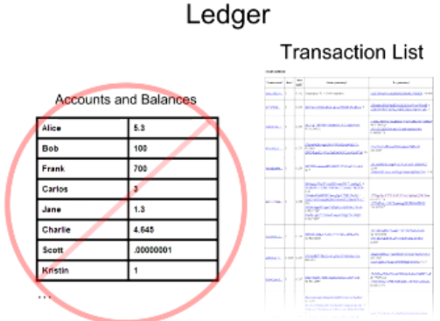
Balance Calculation
16

Slide 11
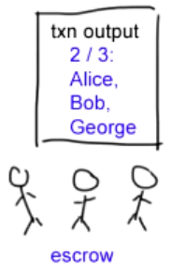
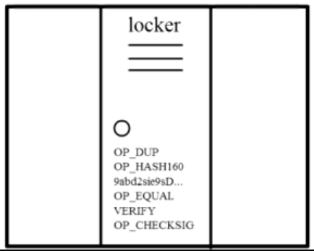
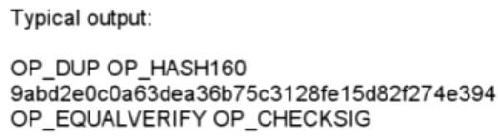
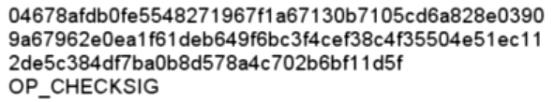
Complex Transactions: Mathematical Puzzles
Transactions: Mathematical Puzzles with locker
Defined with special Scripting language
Only owner can solve it
Support more complex conditions
First Transaction: 2009, Jan 3, 50BTC

Slide 12
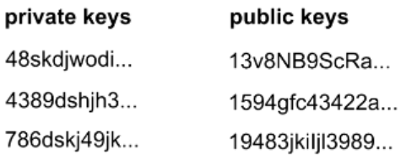
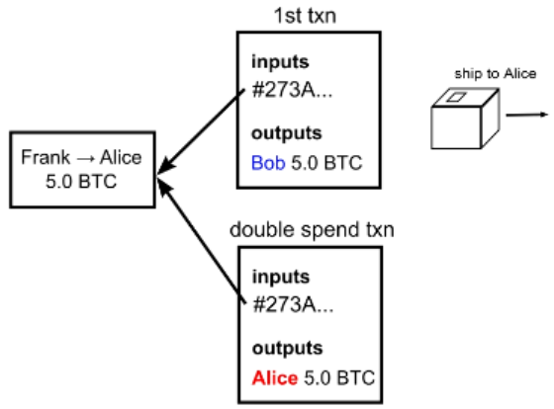
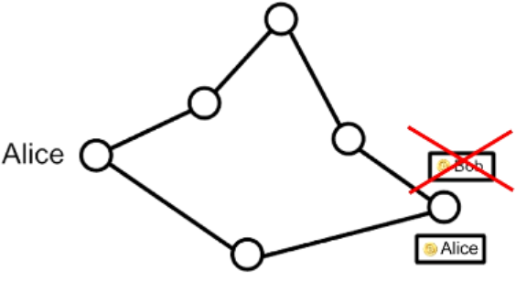
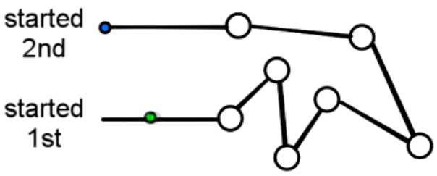
Transaction Security
Wallet
Anonymity
Possible bitcoin address: 2^160
Bitcoin transaction Security:
Digital Signatures
Referenced Transactions
Security Hole: Transaction Order
Double Spending Fraud
Nodes need to agree on transaction order

Slide 13
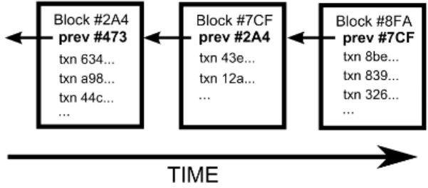
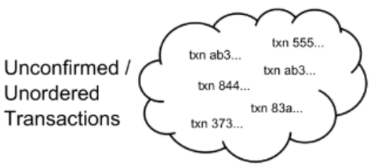
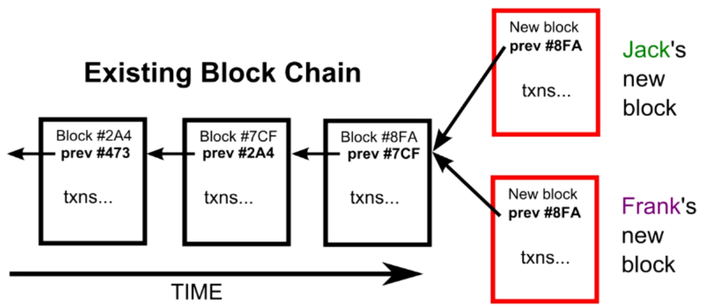
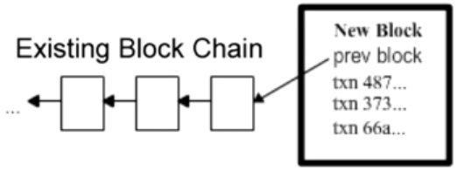
Block Chain
The Block Chain: Ordering Solution
Transaction Chain: History of Ownership
Unconfirmed Transactions
Add to new Block
Potential next blocks

Slide 14
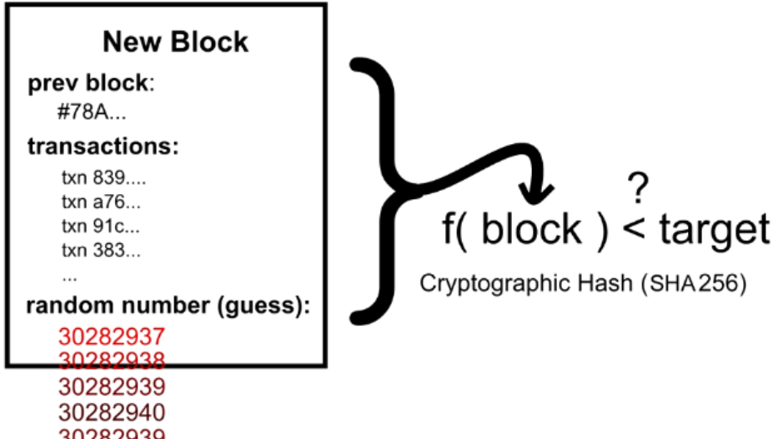
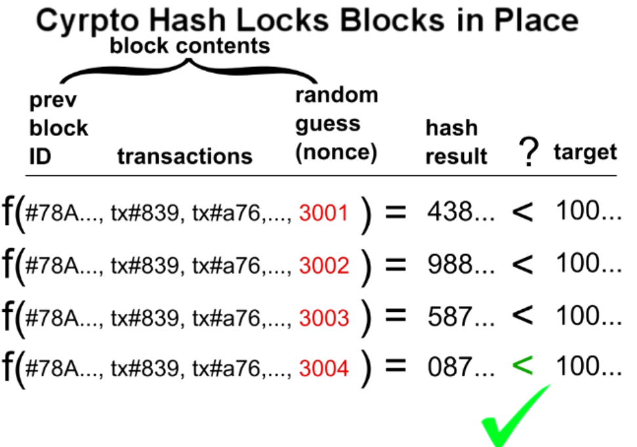
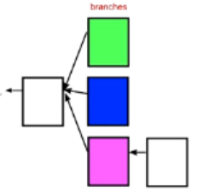
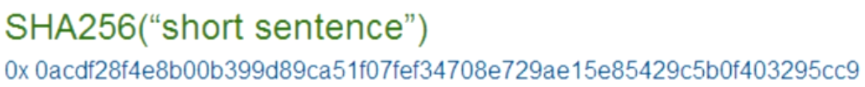
Cryptographic Hash
Block Puzzle
Block Puzzle: SHA256
Target: 000000000000A1B7E…

Slide 15
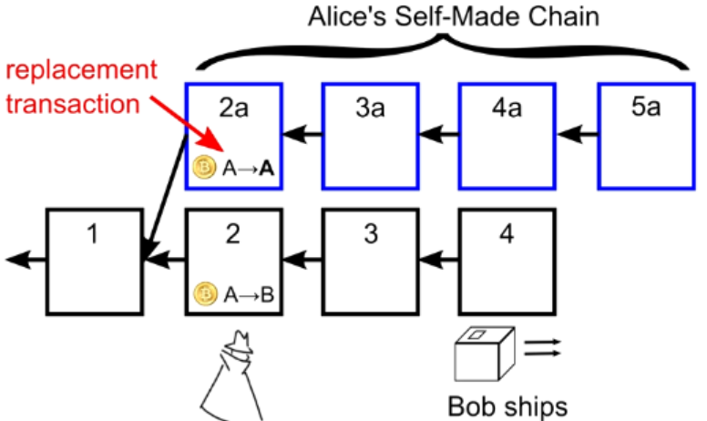
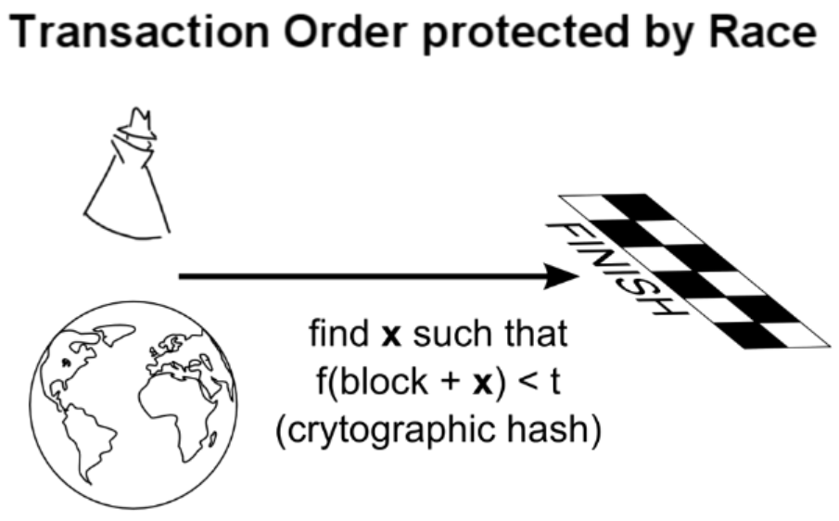
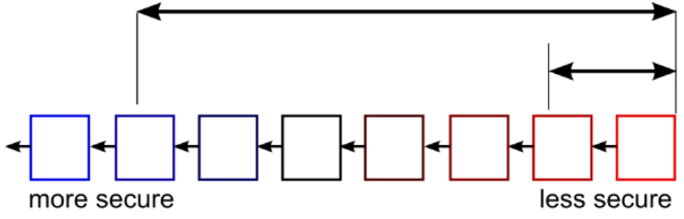
Double Spending Prevention
Only vulnerable at end of the chain: wait for several blocks before final
The attacker must out space or “out luck” the network”

Slide 16
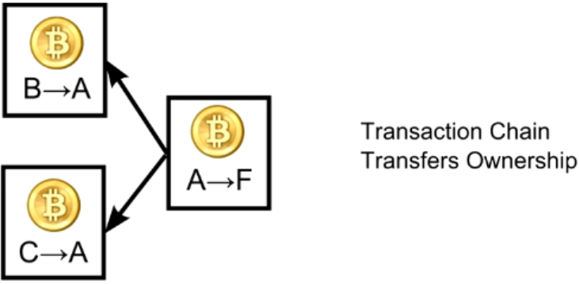
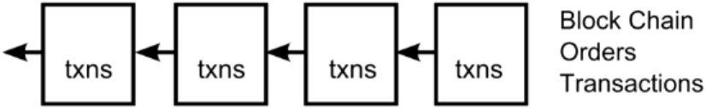
Recap
Next: BitCoin

Slide 17
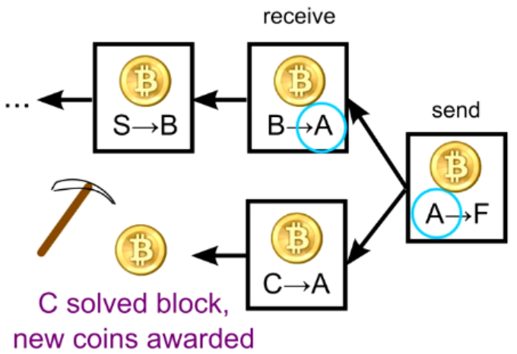
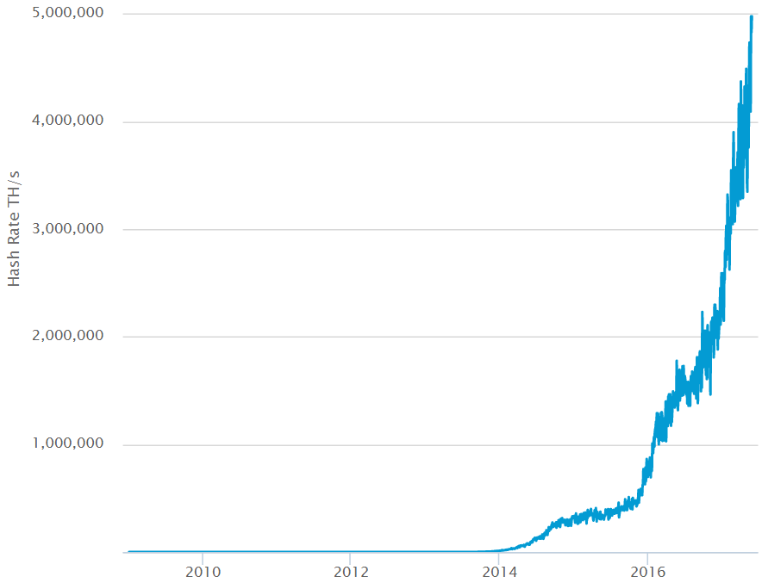
Mining
Real purpose:
Verify transactions
Safeguard the block chain
Mining:
Every 4 years, cut in half, every 10 minutes
all 21 million in 2140
Current 16.3 million
Smallest: 1/100,000,000 BitCoin = 1 Satoshi
Future: transactions
How 10 minutes:
Adjust difficulty every 2016 blocks, (around 2 weeks)
Links

Slide 18
Summery
Benefits
Government can’t print money or manipulate currency
Anonymity
Lower global transaction costs
Challenges
Difficult to exchange
Used for illegal activity (Government can’t track
Mining, or solving blocks use large amount of energy
Mathematically protected digital currency
Maintained by a network of peers
Digital Signature:
Safeguard money
Transaction chains
Store history of ownership
Block Chain
Hold transaction order

Slide 21
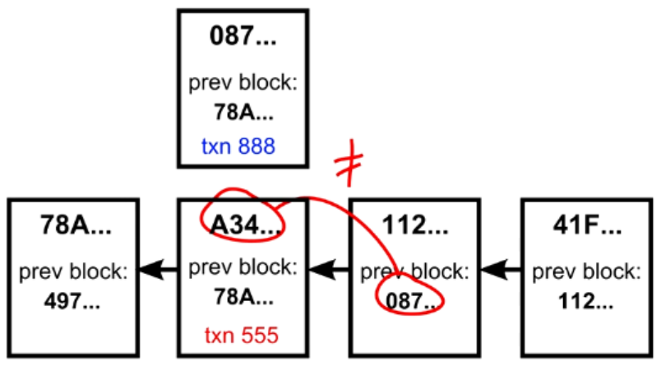
Double Spending in the Block Chain

